Slide 1
Kibana Tutorial
Michael Brumwell, Christian Rodriguez, Mario Arguello, Brianne Phillips
Notes:
Font size 24

Slide 2
Kibana and Data Setup

Slide 3
Kibana and Data Setup
Step 1: Download the hc_flu_vaccination csv data
Step 2: Open Kibana and select Machine Learning (between Maps and Infrastructure) on the Right-Side toolbar
Step 3: Under “Import Data” Select Upload File. Drag the data file to the Kibana Screen and confirm the data.
Step 5: Create a new index for the data. Give it the name flu_hospital.
*This lab assumes you are using the client version of Kibana and that you know how to run it
Notes:
Now that we have uploaded and indexed our data, we will be able to use it for the following visualizations.

Slide 4
Create Visualizations

Slide 5
Creating a Bar Graph
Step 1: Click on Visualizations in the right toolbar, then select Vertical Bar Graph. The indexed dataset will be the flu_hospital index
Step 2: Under Metrics, look at the fields under Y-Axis and ensure the following fields are set correctly:
Aggregation is set to Count
Y-Axis has custom label of Number of Clinics (the Y axis will represent the total number of clinics)
Notes:
For our Bar Graph we will be looking at the top 5 clinics with vaccinated personnel by county. We will only be using a select number of clinics in order to make the graphs look neat and easy to find the data we’re looking for.

Slide 6
Creating a Bar Graph
Step 3: Look at the Buckets section under Metrics and click add. A menu appears with 3 sections, select X-axis.
Step 4: Ensure the following for the X-axis:
Aggregation - Terms (“-“ ---> is set to)
Field - County
Order By - Metrick: Number of Clinics
Order - Descending
Size - 5
Notes:
Now we are going to organize our data into buckets.
The X-axis is what we’re going to use to divide our clinics by county. For the Fields of our new X-axis ensure the following:

Slide 7
Creating a Bar Graph
Step 5: To include the percentage of vaccinated personnel do the following:
Under X-axis, click ADD then click Split Series
Sub aggregation - Terms
Field - HCP_Percent_Vaccinated
Order By - Metric: Number of Clinics
Order - Descending
Size - 5
Custom Label - Percent Personnel Vaccinated
Save as Flu-Hosp Bar Graph
Notes:
Now we currently have a bar graph with a Y-axis showing the number of clinics and the X-axis separated by top 5 counties with the greatest number of clinics. To include the percentage of vaccinated personnel we will do the following:

Slide 8
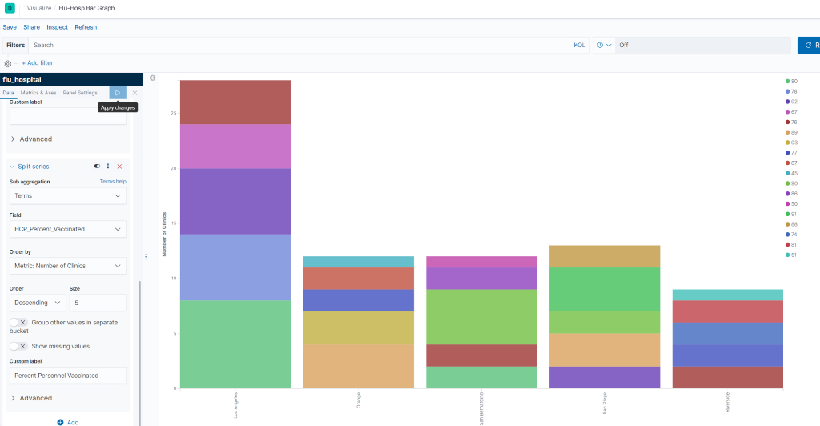
Notes:
Results should look like this

Slide 9
Creating a Pie Graph
Step 1: Under Metrics block, ensure the following:
Under Slice Size
Aggregation is set to Count
Custom label set to Number of Clinics
Under Buckets
Aggregation - Terms
Field - County
Order By - Metric: Number of Clinics
Order - Desc
Size - 7
Custom Label - Number of County Clinics
Notes:
For this pie graph, we are going to check the clinics with the lowest 5 percentage of vaccinated personnel using our hospital index

Slide 10
Creating a Pie Graph
Step 2: Create a new sub-bucket using the Split Slices option
Aggregation - Terms
Field - HCP_Percent_Vaccinated
Order By - Metric:Number of Clinics
Order - Ascending
Size - 5
Custom Label - Personnel Vaccinated (%)
Save the graph as Percent Vaccinated Personnel by County
Notes:
Now we have a slice with a single ring, representing the top 7 counties with the most number of flu clinics. Now we are going to further visualize our data to determine the clinics with the least amount of vaccinated personnel. To finish visualizing the data, we are going to do the following:

Slide 11
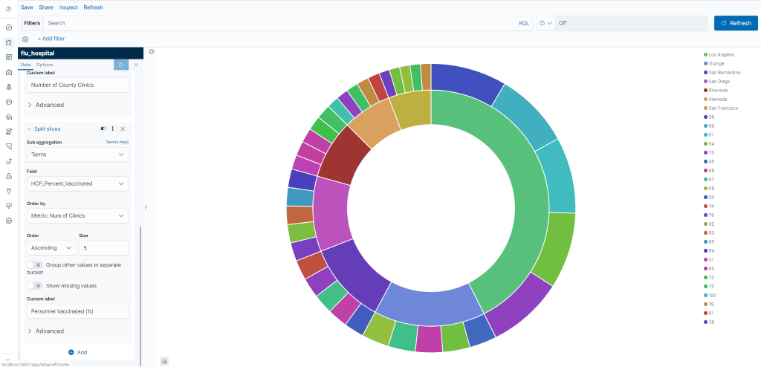
Notes:
Results should look like this

Slide 12
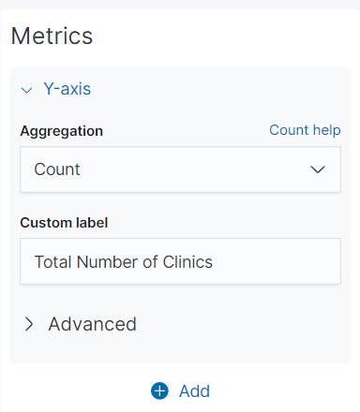
Creating Bar Graph 2
Step 1: Create a new Vertical Bar Graph using the hospital index
Step 2: Under Y-axis, sent the following
Aggregation - Count
Custom Label - Total Number of Clinics
Notes:
Create a new Vertical Bar Graph using the hospital index

Slide 13
Creating Bar Graph 2
Step 2: Click ADD button below Y-axis and click X-axis, then set the following:
Aggregation - Terms
Field - County
Order By - Metric:Number of Clinics
Order - Descending
Size - 5
Custom Label - County
Save the graph as Percent Vaccinated Personnel by County
Notes:
Now we separate our clinics by county by doing the following:

Slide 14
Creating Bar Graph 2
Step 3: Further organize data by separating the chart into parts
Add new sub-bucket and click Split Chart
In row that says Rows and Columns, select Rows
Sub aggregation - Terms
Field - On Track To Achieve 90% by 2020
Order By - Metric: Total Number of Clinics
Order - Ascending
Size - 5
Notes:
In order to further determine clinic eligability, we need to further organize our data by seperating the chart into parts.

Slide 15
Creating Bar Graph 2
Step 4: Split to see percentage of people vaccinated
Create Split Series sub-bucket
Sub aggregation - Terms
Field - HCP_Percent_Vaccinated
Order By - Metric: Total Number of Clinics
Order - Descending
Size - 5
Save the graph as clinics_on_track bar graph
Notes:
Now we have our graph separated by county, and separated into 3 graphs separated by yes, no, and ‘DNR’ but we still want to see the percentage of people that have been vaccinated.

Slide 16
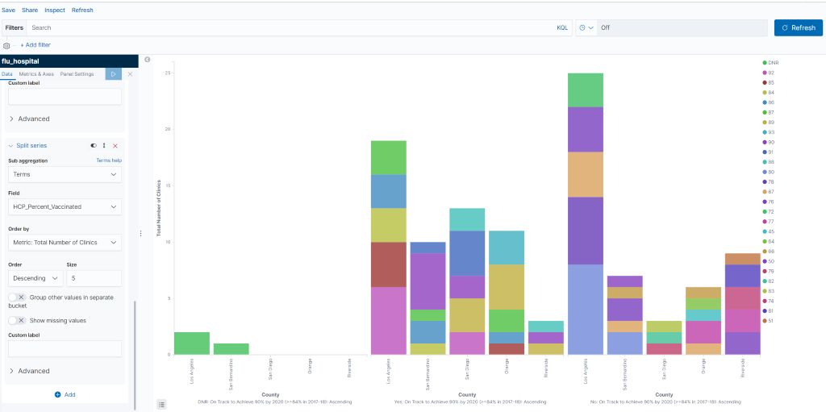
Notes:
Results should look like this

Slide 17
Creating a Dashboard
Step 1: Click the dashboard icon on the left toolbar in Kibana, click add to create a new dashboard. A list will appear with existing visualizations.
Step 2: Click the three that were just created and save as Hospital Dashboard.
Notes:
Now that we have our 3 graphs, we can use kibana to organize them in a dashboard for easy access.

Slide 18
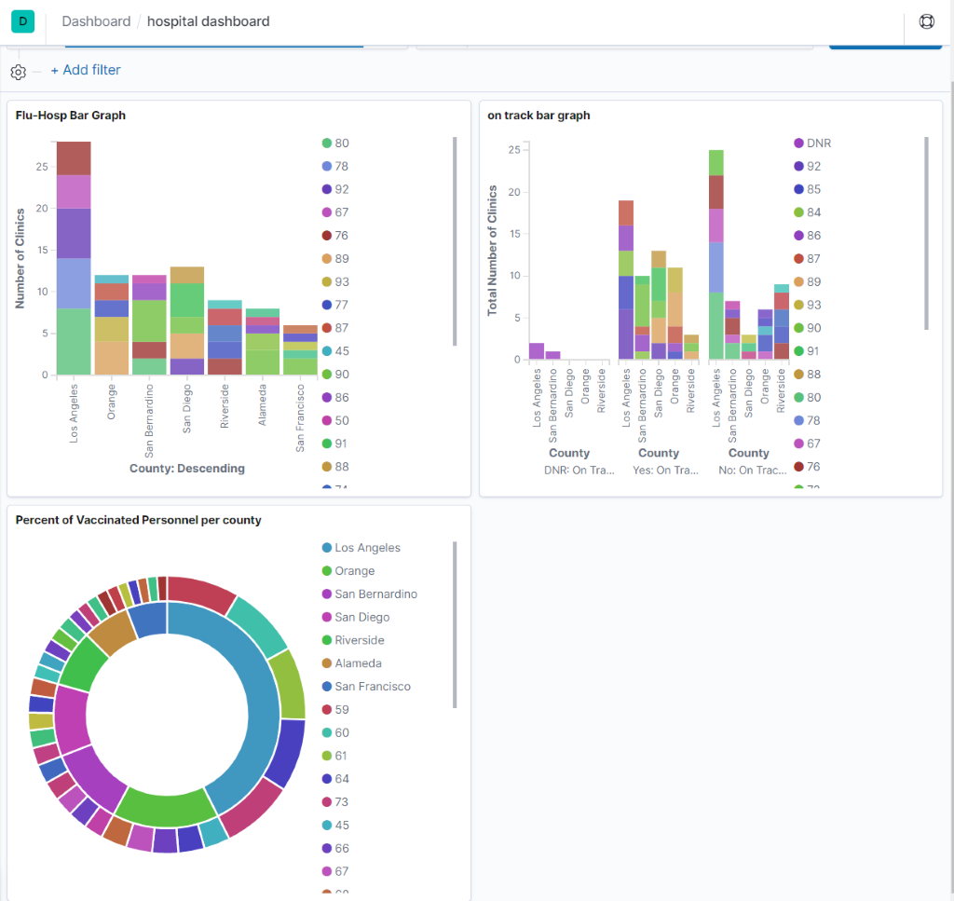
Notes:
Results should look like this

Slide 19
Creating a Geospatial Map with Excel
Step 1: Open the data in Excel.
Step 2: Highlight the data by left-clicking the first field of the first column and dragging it until every record is highlighted.
Step 3: In top left corner, select Insert, then Maps, then Filled Maps
Now a map of California will appear with clinic locations, but we need to remove some extra data
Notes:
Because the data we are using doesn’t contain geo hash coordinates, we are unable to create a coordinate map using Kibana. Since the data includes county names in California, we can use that data to create a map of California.

Slide 20
Creating a Geospatial Map with Excel
Step 4: Right click the map and select Select Data
Step 5: In the left box, remove Facility_name and Facility_ID
Step 6: Name the map “Vaccinated Personnel by County” where it says Chart Title

Slide 21
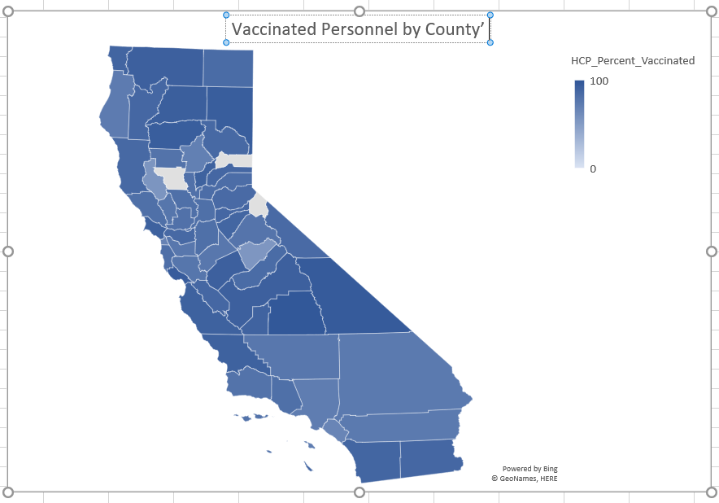

Slide 22
End of Tutorial

